Slide 1
Nashville Gov Selling Stuff
How Nashville Benefits from eBid.com

Slide 2
Basic Facts
The city of Nashville has random stuff laying around.
These items come from schools, offices, confiscations, and other assorted means of acquisition.

Slide 3
Basic Facts
This includes “property for which there is no readily apparent need within Metro or seized, confiscated, forfeited, abandoned, or court ordered sale items.”
https://www.nashville.gov/departments/general-services/surplus-property-distribution

Slide 4
Basic Facts
The city of Nashville has no need to keep these items. In fact, it needed a way to discard these items, and someone smart found an excellent resource allowing the sale of these items…

Slide 5


Slide 6
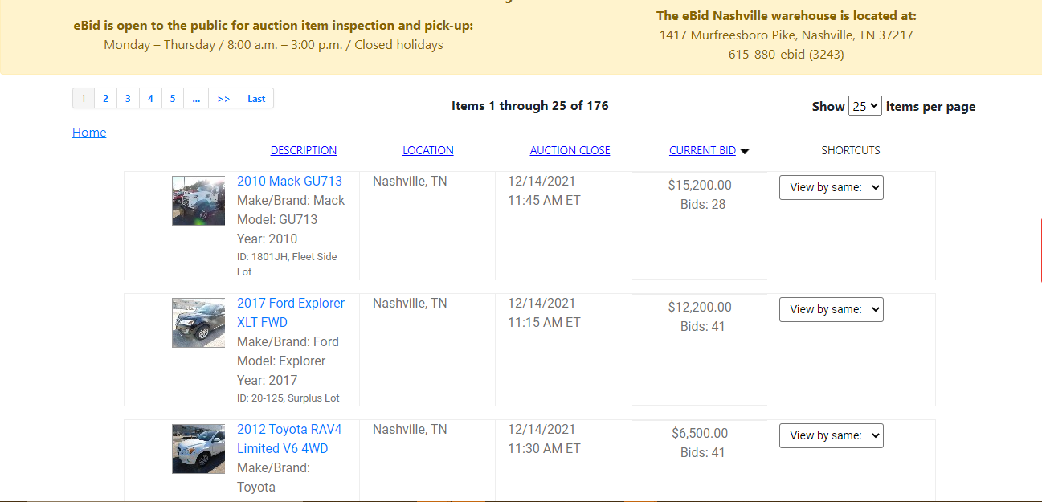

Slide 7
Basic Facts
The data from the sale of these items is publicly available to anyone with access to the internet. The link can be found below for any interested parties who wish to further explore:
https://data.nashville.gov/Business-Development-Housing/eBid-Monthly-Sales/n54t-t7gg

Slide 8
What I Have Done with the Data
I have used Excel to categorize the departments and match them to department names in the Metro Nashville Budget
I have categorized each item type by searching for keywords in the titles and adding the appropriate category.
For example, any vehicle with a large motor was given the category ‘Car’, and I searched all manner of car keywords like ‘car’, ‘ford’, ‘buick’, ‘truck’, ‘van’, ‘motorcycle’, etc. and added a VLookup to my unique categories list (column AE in the following screenshot).
I did the same for Department (Column AA) to Dept Actual (AB, which is a list of departments from the budget spreadsheet).

Slide 9
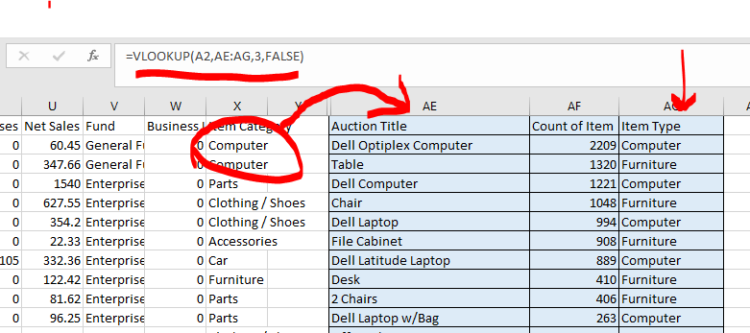
What I Have Done with the Data

Slide 10

Current Data Set Facts
Data is current as of Oct 2021
Dates begin in 2013
Nashville has profited over $40M since then
The fields included are:
Lot/item name, auction id, department of origin, close date, winning date, credit card fee, fee percent, auction fee, pay status, paid date, a few record number fields, net sales, and which fund the sale money goes to.

Slide 11
Current Data Set Facts
There are 41,146 total lots from eBid sales since its inception
The average winning bid was $1057.13 with the average net profit as $984.41.
Total sales for all time: $40,498,457.35
Total auction fees: $3,819,798.60.

Slide 12

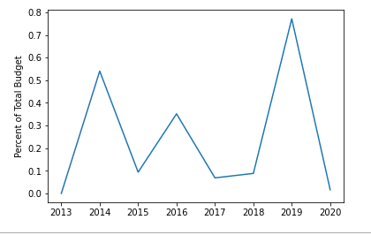
The eBid total revenue makes up some percentage of Nashville’s overall budget.
This graph show the percentage that eBid sales actually comprise. While 0.7% of the overall budget may not look impressive, it actually is.
Let’s look at that in dollars.

Slide 13
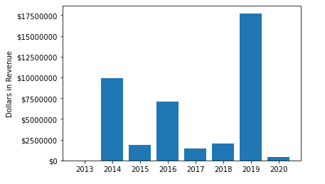
eBid Sales
As you can see here, the millions of dollars made by eBid sales is nothing to sneeze at.
Still, if we looked at the eBid revenue in comparison to the Nashville budget, how did the different dept categories fare throughout the years?
I thought you might ask!

Slide 14
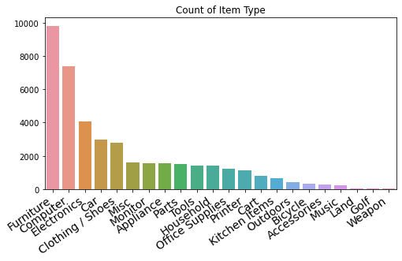

Slide 15
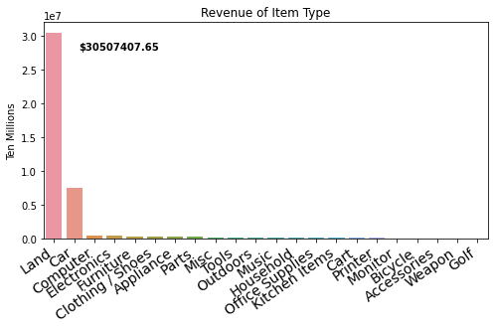
Not too shabby!

Slide 16
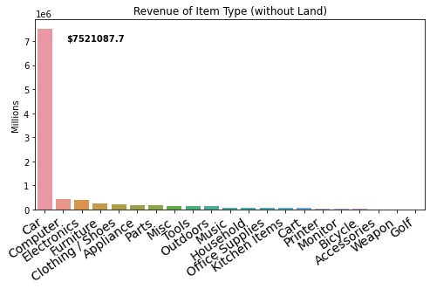

Slide 17
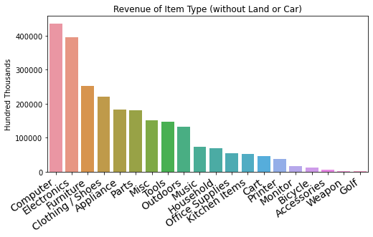

Slide 18
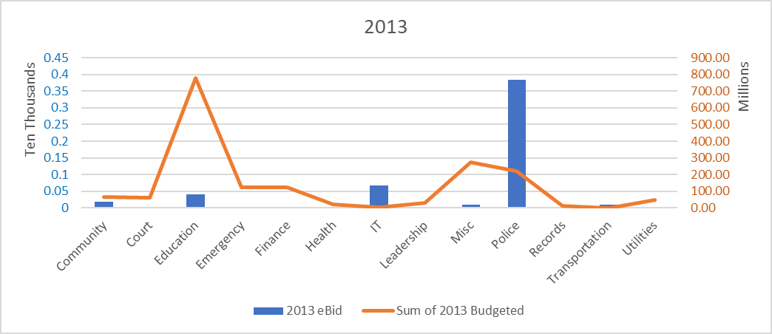

Slide 19
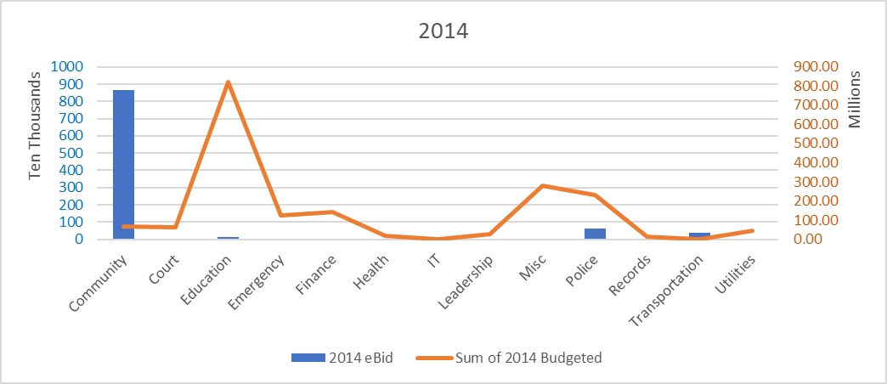

Slide 20
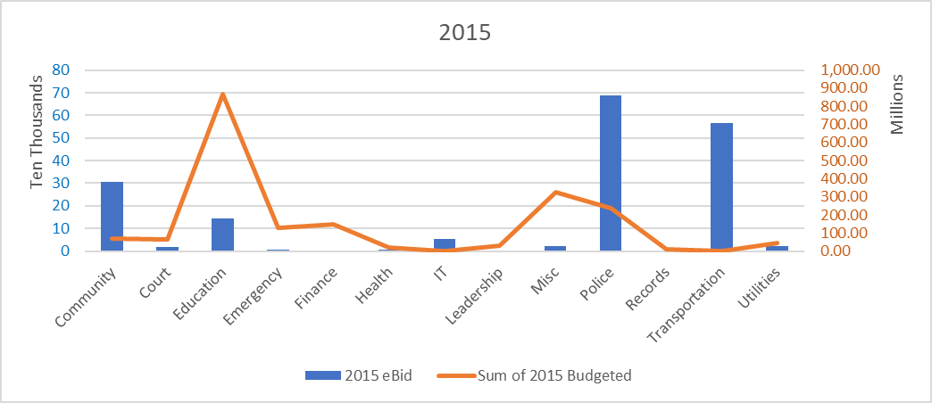

Slide 21
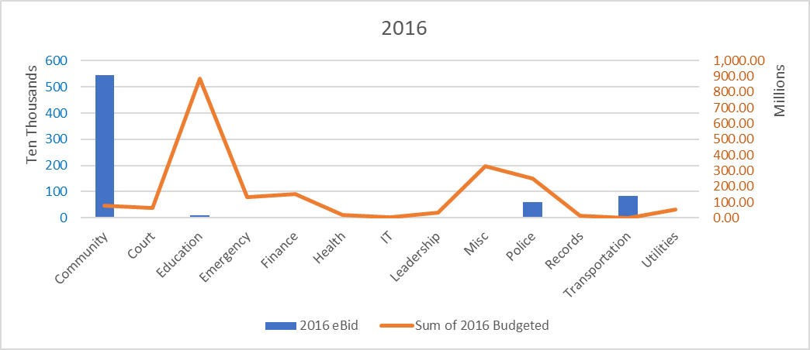

Slide 22
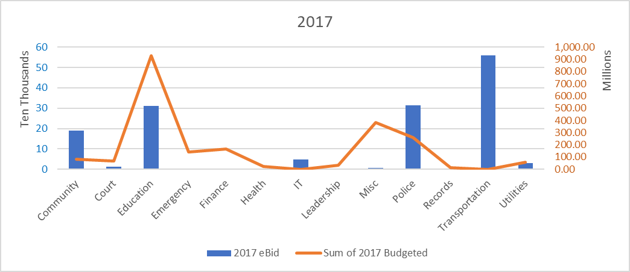

Slide 23
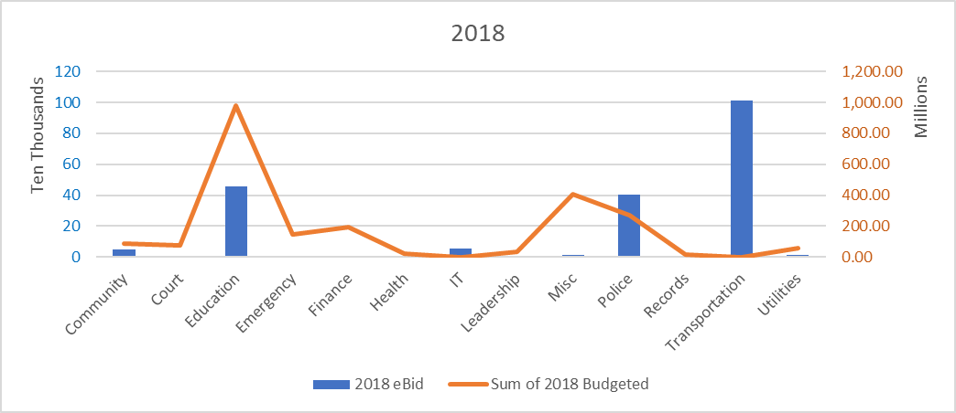

Slide 24
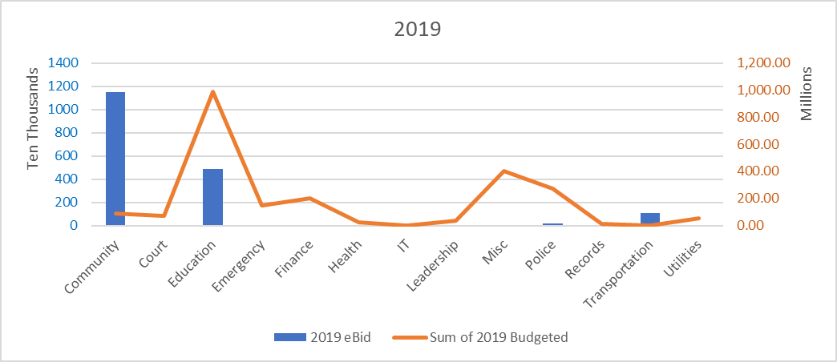

Slide 25
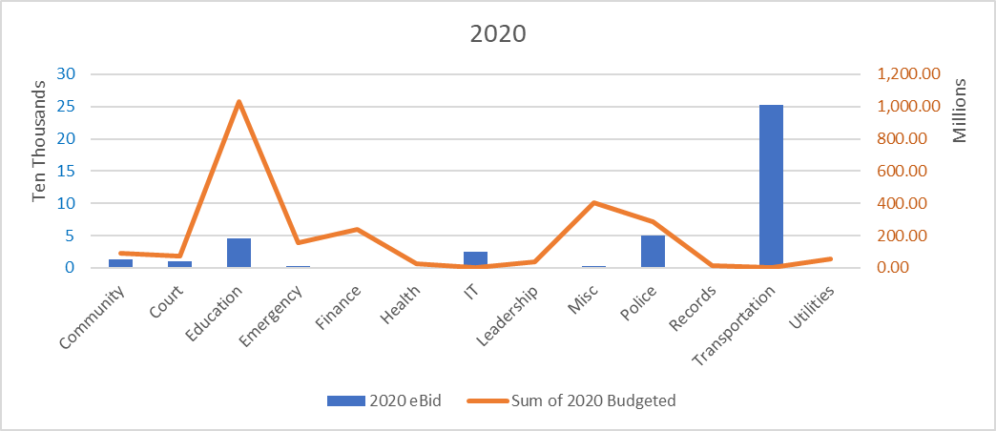

Slide 26
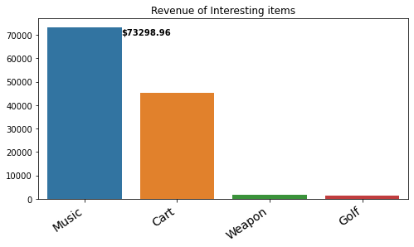
Interesting Item Types & Their Total Revenues

Slide 27
Music's largest sale: $51815.0
Music's smallest sale: $0.77
Music's average profit: $305.41
Music's median profit: $30.915
Music's item count: 240

Slide 28
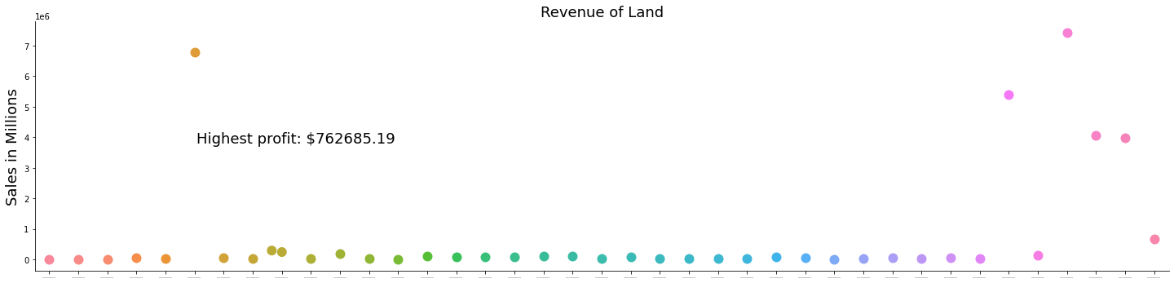
The revenue of land is definitely what has carried the weight of the revenues throughout the years.
There are a few hero properties out of the thousands of lots that Nashville has sold that have made this project as wildly profitable as it has been.
Still, overall, this ingenious green move will continue to serve Nashville for years to come.

Slide 29
END

